Slide 1
Mindful Breathing & Concentration
Straight back, folded legs if you are sitting on a matt or cushion, or legs grounded if on a chair
Chin slightly tugged in or dropped to feel at ease
Hands resting on the knees or thighs with palms upwards
Eyes slightly opened to see barely your knees or closed
Tongue lightly touching the upper palette
Lips closed, teeth not biting
Shoulder relaxed

Slide 2
Three Cs and our Judgments
Rekhi Centre, Science of Happiness 22 Jan 2019
Saamdu.Chetri@iitkgp.ac.in WhatsApp : +975 17212121

Slide 3
Causes of discontentment
Greed
Excessive desires
Jealousy
Pride (Ego)
Ignorance
Competition (voice of fear)
Comparing (voice of judgement)
Complaining (voice of cynicism)

Slide 4
Category of Stress
Acute: short-term events that can be traumatic and quick but it can have lasting impact (severe, PTS)
Chronic: long-term events, due to illness, or bad job, or broken relationship
Episodic: also short term, which we often experience at work or home (worry warts)

Slide 5
Type of stress
Divide Self with Self
Past or future events
Self image
Discontentment
Divide Self with Others
Social
3 Cs
Work
Relationships
Personal loss
Divide Self with Environment
Health
Changes in lives
Financial worries
A Japanese way to be peaceful

Slide 6
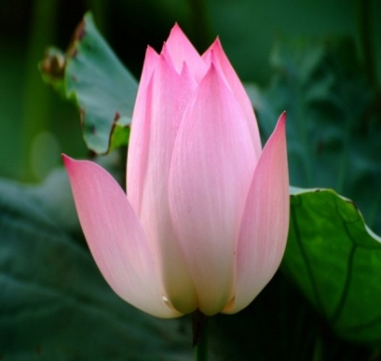
Art of Contentment
Mindfulness is living in the present moment being aware .
FIVE STEPS TO MINDFULNESS
MINDFUL BREATHING
CONCENTRATION
AWARENESS OF BODY
RELEASING TENSION
MINDFUL WALKING

Slide 7
Art of Contentment
Avoid competition (VoF): living others life – create win-win situation) Address the things you control. Let go of everything else
Avoid comparing – VoJ (you are not the other) creating contentment, gratification and confidence is the best way possible to discover your passion and share it with the world
Stop complaining -VoC (seek insight into the truth) you don’t like something happening, address the things that need addressing, but just don’t complain about it
Acceptance and letting go:
Less – art of contentment (subtract greed)
More – learn to share it

Slide 8
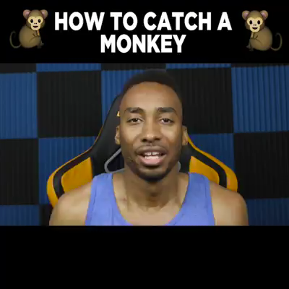
Are we because of Monkeys?
Are we because of Monkeys?

Slide 9
Remember
Truth is, there is only one you! So be you in everything you do.
Create a life of contentment, gratification and confidence to discover your passion and share it with the world.
How do you view the things currently in your life? As students? What about in your hostel life? Love life?

Slide 10
Busyness
Mismatch (Feeling of need to do, like to do, aught to do, what you can actually do - widens the gap)
Voices of judgment, cynicism and fear kicking in us
Anxiety to remain known, on the top, connected but not able to short out important to know, need to know, and nice to know – we function from first, third and fourth quadrangles of prioritising work.

Slide 11
Busyness (cont.)
Feeling - the feeling of too much & not the share number things on the plate
Mismatch – like to do, aught to do, capability of doing
Our human limitations – our finite energy and need for sleep, the number of hours in a day – remain the same as ever
Social media – reaches you anywhere at any time

Slide 12
An Essay

Slide 13
Overcoming Busyness
Trade offs: Resources are limited – prioritize work, by deliberately neglecting unnecessary, and focus on important and not urgent.
Production capability: respect your body, 2 hours work and ten minuets refreshing, take power naps – freshness of 2 hours work is qualitative than 5 hours of work with depleted feelings.
Volunteer: Give your time away

Slide 14
Busyness (cont.)
Watch out for time debts: Answering emails – will come back – create time assets to reduce further work down the line
Slow down: however wrong that feels but in the process you work more…e.g. on a treadmill…
Try the five-item to-do list: Prioritise work and do not pick up next until you have completed this list…important first
Stop busy-bragging: Don’t make others feel rushed – anxiety is contagious – we make life trivial by moaning how busy we are

Slide 15
Busyness (cont.)
Practice strategic incompetence
Build in buffers (time more than required for a work)
Beware of Precrastination (opposite of Procrastination)

Slide 16

Busyness
Busyness

Slide 17

Tashi Delek Zhu!
Happiness is here and now, I have dropped my worries, nowhere to go, nothing to do, and I am not in a hurry.
Happiness is here and now, I have dropped my worries, somewhere to go, something to do, but I am not in a hurry.
May you be well and happy always
May you find happiness in what you do
May you bring happiness to the lives you touch
May you be the northern star for yourself, family, friends, society and the world.

